Slide 1

Go, change the world
RV College of
Engineering
Service Oriented Architecture for Distributed Computing–Unit 3:
22MCN1B2T
By
Prof Srividya M S,
Department of CSE,
RVCE
*
‹#›

Slide 2

RV College of
Engineering
Go, change the world
UNIT-3:
Service Oriented Architecture for Distributed Computing:
Services & SOA,
Message Oriented Middleware,
Workflow in SOA,
Cloud Programming & Software Environments:
Features of Cloud &Grid,
Parallel & Distributed programming paradigms,
Programming support of Google Cloud, Amazon AWS & Azure.
*
‹#›

Slide 3
SERVICES AND SERVICE-ORIENTED ARCHITECTURE
SOA is about how to design a software system that makes use of services of new or legacy applications through their published or discoverable interfaces.
These applications are often distributed over the networks.
SOA also aims to make service interoperability extensible and effective.
It prompts architecture styles such as loose coupling, published interfaces, and a standard communication model in order to support this goal.
The World Wide Web Consortium (W3C) defines SOA as a form of distributed systems architecture characterized by the following properties:
*
‹#›

Slide 4
Logical view:
The SOA is an abstracted, logical view of actual programs, databases, business processes, and so on, defined in terms of what it does, typically carrying out a business-level operation.
The service is formally defined in terms of the messages exchanged between provider agents and requester agents.
Message orientation:
The internal structure of providers and requesters include the implementation language, process structure, and even database structure.
These features are deliberately abstracted away in the SOA:
Using the SOA discipline one does not and should not need to know how an agent implementing a service is constructed.
By avoiding any knowledge of the internal structure of an agent, one can incorporate any software component or application to adhere to the formal service definition.
Description orientation:
A service is described by machine-executable metadata.
The description supports the public nature of the SOA:
Only those details that are exposed to the public and are important for the use of the service should be included in the description.
The semantics of a service should be documented, either directly or indirectly, by its description.
*
‹#›

Slide 5
Granularity Services tend to use a small number of operations with relatively large and complex messages
Network orientation Services tend to be oriented toward use over a network, though this is not an absolute requirement.
Platform-neutral Messages are sent in a platform-neutral, standardized format delivered through the interfaces. XML is the most obvious format that meets this constraint
SOA focuses on loosely coupled software applications running across different administrative domains, based on common protocols and technologies, such as HTTP and XML.
SOA is related to early efforts on the architecture style of large-scale distributed systems, particularly Representational State Transfer (REST).
Nowadays, REST still provides an alternative to the complex standard-driven web services technology and is used in many Web 2.0 services.
*
‹#›

Slide 6
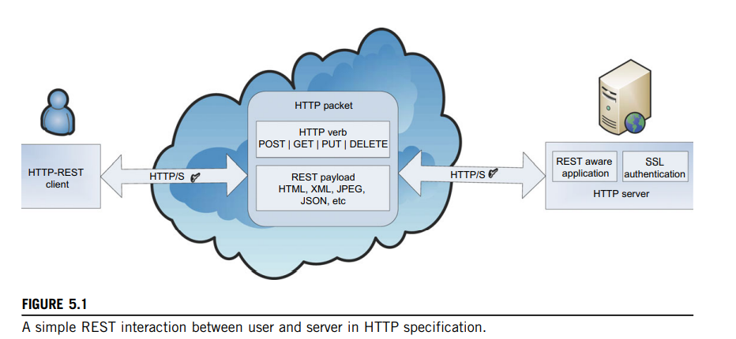
REST and Systems of Systems
REST is a software architecture style for distributed systems, particularly distributed hypermedia systems, such as the World Wide Web
It has recently gained popularity among enterprises such as Google, Amazon, Yahoo!, and especially social networks such as Facebook and Twitter because of its simplicity, and its ease of being published and consumed by clients.
REST, was introduced and explained by Roy Thomas Fielding, one of the principal authors of the HTTP specification, in his doctoral dissertation in 2000
*
‹#›

Slide 7
Resource Identification through URIs:
The RESTful web service exposes a set of resources which identify targets of interaction with its clients.
Each particular resource is identified by a unique name, or more precisely, a Uniform Resource Identifier (URI)
Similar to URL, providing a global addressing space for resources involved in an interaction between components as well as facilitating service discovery
Uniform, Constrained Interface:
Interaction with RESTful web services is done via the HTTP standard, client/server cacheable protocol.
Resources are manipulated using a fixed set of four CRUD (create, read, update, delete) verbs or operations:
Self-Descriptive Message:
A REST message includes enough information to describe how to process the message.
This enables intermediaries to do more with the message without parsing the message contents.
REST provides multiple/alternate representations of each resource.
Metadata about the resource is available and can be used for various purposes, such as cache control, transmission error detection, authentication or authorization, and access control
Stateless Interactions:
The REST interactions are “stateless” in the sense that the meaning of a message does not depend on the state of the conversation.
Stateless communications improve visibility, reliability, scalability and allows the server component to quickly free resources. S
Several techniques exist to exchange state, such as URI rewriting, cookies, and hidden form fields.
*
‹#›

Slide 8
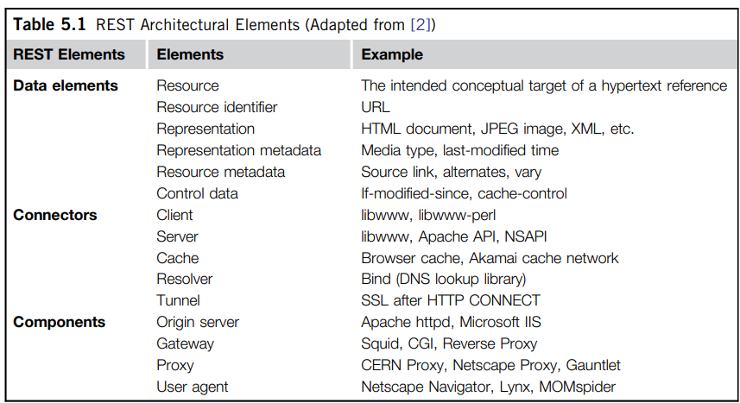
*
‹#›

Slide 9
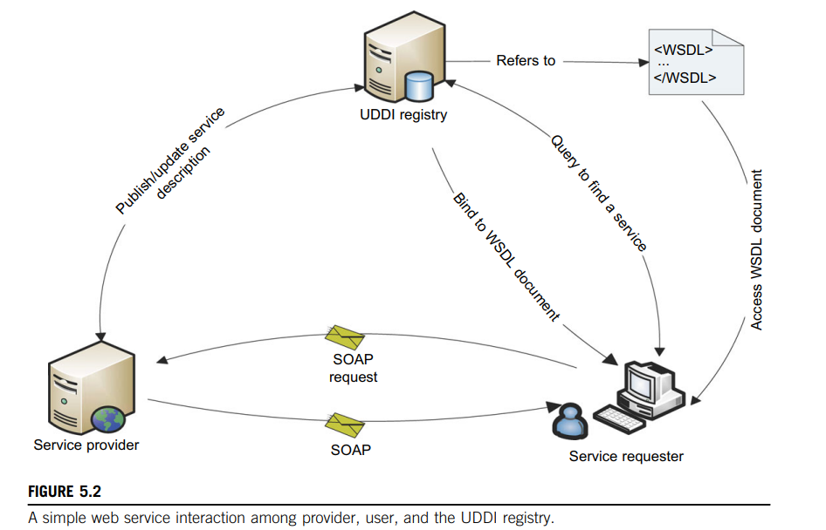
Services and Web Services
In an SOA paradigm, software are delivered and consumed via loosely coupled, reusable, coarse-grained, discoverable, and self-contained services interacting via a message-based communication model.
The web has becomes a medium for connecting remote clients and, integrating applications across the Internet.
The term “web service” is often referred to a self-contained, self-describing, modular application designed to be used and accessible by others across the web.
Once a web service is deployed, other applications and other web services can discover and invoke the deployed service
*
‹#›

Slide 10
Simple Object Access Protocol (SOAP) SOAP provides a standard packaging structure for transmission of XML documents over various Internet protocols, such as SMTP, HTTP, and FTP.
By having such a standard message format, heterogeneous middleware systems can achieve interoperability.
A SOAP message consists of a root element called envelope, which contains a header: a container that can be extended by intermediaries with additional application-level elements such as routing information, authentication, transaction management, message parsing instructions, and Quality of Service (QoS) configurations, the payload of the message.
The content of the payload will be marshaled by the sender’s SOAP engine and un marshaled at the receiver side, based on the XML schema that describes the structure of the SOAP message.
Web Services Description Language (WSDL) WSDL describes the interface, a set of operations supported by a web service in a standard format.
It standardizes the representation of input and output parameters of its operations as well as the service’s protocol binding, the way in which the messages will be transferred on the wire.
Using WSDL enables disparate clients to automatically understand how to interact with a web service.
Universal Description, Discovery, and Integration (UDDI) UDDI provides a global registry for advertising and discovery of web services, by searching for names, identifiers, categories, or the specification implemented by the web service
*
‹#›

Slide 11
SOAP is an extension, and an evolved version of XML-RPC, a simple and effective remote procedure call protocol which uses XML for encoding its calls and HTTP as a transport mechanism, introduced in 1999.
According to its conventions, a procedure executed on the server and the value it returns was a formatted in XML.
However, XML-RPC was not fully aligned with the latest XML standardization.
Moreover, it did not allow developers to extend the request or response format of an XML-RPC call.
As the XML schema became a W3C recommendation in 2001, SOAP mainly describes the protocols between interacting parties and leaves the data format of exchanging messages to XML schema to handle.
The major difference between web service technology and other technologies such as J2EE, CORBA, and CGI scripting is its standardization, since it is based on standardized XML, providing a language-neutral representation of data.
Most web services transmit messages over HTTP, making them available as Internet-scale applications.
In addition, unlike CORBA and J2EE, using HTTP as the tunneling protocol by web services enables remote communication through firewalls and proxies.
SOAP-based web services are also referred to as “big web services”.
SOAP-based web services interaction can be either synchronous or asynchronous, making them suitable for both request-response and one-way exchange patterns, thus increasing web service availability in case of failure
*
‹#›

Slide 12
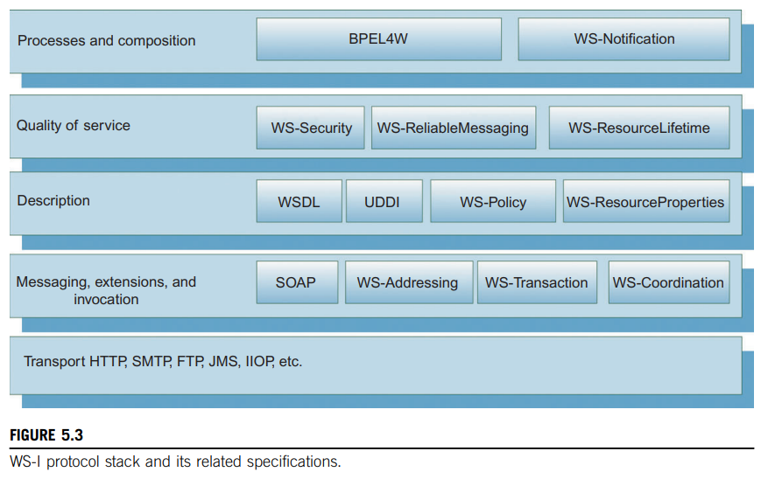
WS-I Protocol Stack
Web services provide on-the-fly software composition, through the use of loosely coupled, reusable software components.
By using Business Process Execution Language for Web Services (BPEL4WS), a standard executable language for specifying interactions between web services
BPEL4WS is an XML-based language, built on top of web service specifications, which is used to define and manage long-lived service orchestrations or processes
In BPEL, a business process is a large-grained stateful service, which executes steps to complete a business goal.
The goal can be the completion of a business transaction, or fulfillment of the job of a service
*
‹#›

Slide 13
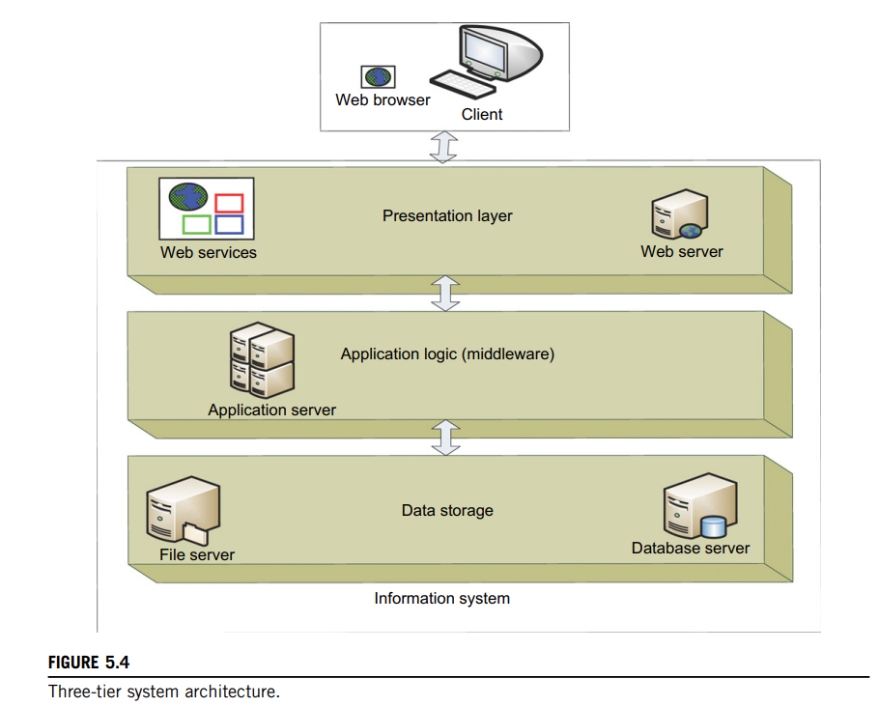
Enterprise Multitier Architecture
Enterprise applications often use multitier architecture to encapsulate and integrate various functionalities.
Multitier architecture is a kind of client/server architecture in which the presentation, the application processing, and the data management are logically separate processes.
The simplest known multilayer architecture is a two-tier or client/server system.
This traditional two-tier, client/server model requires clustering and disaster recovery to ensure resiliency.
While the use of fewer nodes in an enterprise simplifies manageability, change management is difficult as it requires servers to be taken offline for repair, upgrading, and new application deployments.
Moreover, the deployment of new applications and enhancements is complex and time-consuming in fat-client environments, resulting in reduced availability
*
‹#›

Slide 14
Presentation layer Presents information to external entities and allows them to interact with the system by submitting operations and getting responses
Business/application logic layer or middleware Programs that implement the actual operations requested by the client through the presentation layer.
The middle tier can also control user authentication and access to resources, as well as performing some of the query processing for the client, thus removing some of the load from the database servers.
Resource management layer Also known as the data layer, deals with and implements the different data sources of an information system.
N-tier architecture is characterized by the functional decomposition of applications, service components, and their distributed deployment.
Such an architecture for both web services and dynamic web applications leads to reusability, simplicity, extensibility, and clear separation of component functionalities
Web services can be seen as another tier on top of the middleware and application integration infrastructure
*
‹#›

Slide 15
Grid Services and OGSA
OGSA is a service-oriented architecture that aims to define a common, standard, and open architecture for grid-based applications.
“Open” refers to both the process to develop standards and the standards themselves.
In OGSA, everything from registries, to computational tasks, to data resources is considered a service.
These extensible set of services are the building blocks of an OGSA-based grid.
OGSA is intended to:
Facilitate use and management of resources across distributed, heterogeneous environments
Deliver seamless QoS
Define open, published interfaces in order to provide interoperability of diverse resources
Exploit industry-standard integration technologies
Develop standards that achieve interoperability
Integrate, virtualize, and manage services and resources in a distributed, heterogeneous environment
Deliver functionality as loosely coupled, interacting services aligned with industry-accepted web service standards
*
‹#›

Slide 16
Categories of OGSA Services
Infrastructure Services Refer to a set of common functionalities required by higher level services.
Execution Management Services Concerned with issues such as starting and managing tasks, including placement, provisioning, and life-cycle management.
Data Management Services Provide functionality to move data to where it is needed, maintain replicated copies, run queries and updates, and transform data into new formats.
These services must handle issues such as data consistency, persistency, and integrity.
The three base interfaces, Data Access, Data Factory, and Data Management
Resource Management Services Provide management capabilities for grid resources: resources can be monitored, reserved, deployed, and configured as needed to meet application QoS requirements.
Security Services Facilitate the enforcement of security-related policies within a (virtual) organization, and supports safe resource sharing. Authentication, authorization, and integrity assurance are essential functionalities provided by these services.
Information Services Provide efficient production of, and access to, information about the grid and its constituent resources. The term “information” refers to dynamic data or events used for status monitoring; relatively static data used for discovery; and any data that is logged. Troubleshooting is just one of the possible uses for information provided by these services.
Self-Management Services Support service-level attainment for a set of services (or resources), with as much automation as possible, to reduce the costs and complexity of managing the system. These services are essential in addressing the increasing complexity of owning and operating an IT infrastructure
*
‹#›

Slide 17
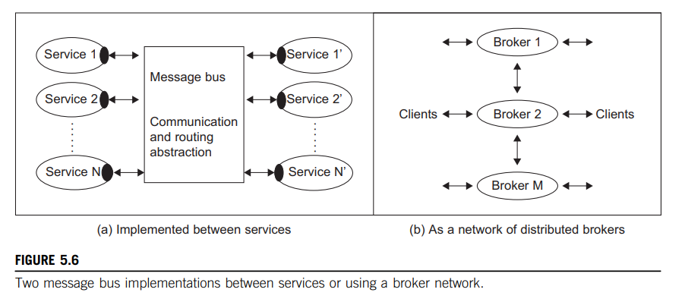
MESSAGE-ORIENTED MIDDLEWARE
Enterprise Bus: The services, by definition, interact with messages with a variety of different formats (APIs), wire protocols, and transport mechanisms.
It is attractive to abstract the communication mechanism so that services can be defined that communicate independent of details of the implementation.
For example, the author of a service should not need to worry that a special port is to be used to avoid firewall difficulties or that we need to use UDP and special fault tolerance approaches to achieve satisfactory latency on a long-distance communication
*
‹#›

Slide 18
Publish-Subscribe Model and Notification
An important concept here is “publish-subscribe” which describes a particular model for linking source and destination for a message bus.
Here the producer of the message (publisher) labels the message in some fashion; often this is done by associating one or more topic names from a (controlled) vocabulary.
Then the receivers of the message (subscriber) will specify the topics for which they wish to receive associated messages.
Alternatively, one can use content-based delivery systems where the content is queried in some format such as SQL.
The use of topic or content-based message selection is termed message filtering.
Each of these cases, there is many-to-many relationship between publishers and subscribers.
Publish-subscribe messaging middleware allows straightforward implementation of notification or event-based programming models.
*
‹#›

Slide 19
Queuing and Messaging Systems
There are several useful standards in this field.
The best known is the Java Message Service (JMS) which specifies a set of interfaces outlining the communication semantics in pub/sub and queuing systems.
Advanced Message Queuing Protocol (AMQP) specifies the set of wire formats for communications; unlike APIs, wire formats are cross-platform.
In the web service arena, there are competing standards, WS-Eventing and WS-Notification, but neither has developed a strong following.
Table 5.8 compares a few common messaging and queuing systems.
We selected two cloud systems: Amazon Simple Queue and Azure Queue. We also list MuleMQ [37], which is the messaging framework underlying the ESB [30,31] system Mule, developed in Java, of which there are 2,500 product deployments as of 2010. The focus of Mule is to simplify the integration of existing systems developed using JMS, Web Services, SOAP, JDBC, and traditional HTTP. Protocols supported within Mule include POP, IMAP, FTP, RMI, SOAP, SSL, and SMTP. ActiveMQ [38] is a popular Apache open source message broker while WebSphereMQ [33] is IBM’s enterprise message bus offering. Finally, we list the open source NaradaBrokering [39] that is notable for its broad range of supported transports and was successfully used to support a software Multipoint Control Unit (MCU) for multipoint video conferencing and other collaboration capabilities. Note that the four noncloud systems support JMS. Also, some key features of messaging systems are listed in the table but are not discussed in this brief section. These are security approach and guarantees and mechanisms for message delivery. Time-decoupled delivery refers to situations where the producer and consumer do not have to be present at the same time to exchange messages. Fault tolerance is also an important property: Some messaging systems can back up messages and provide definitive guarantees. This table is only illustrative and there are many other important messaging systems. For example, RabbitMQ [40] is a new impressive system based on the AMQP standard
*
‹#›

Slide 20
Cloud or Grid Middleware Applications
Three examples are given here to illustrate the use of the NaradaBrokering middleware service with distributed computing. The first example is related to environmental protection. The second is for Internet conferencing and the third is for earthquake science applications
*
‹#›

Slide 21
FEATURES OF CLOUD AND GRID PLATFORMS
Cloud Capabilities and Platform Features: Commercial clouds need broad capabilities, as summarized in Table 6.1. These capabilities offer cost-effective utility computing with the elasticity to scale up and down in power. However, as well as this key distinguishing feature, commercial clouds offer a growing number of additional capabilities commonly termed “Platform as a Service” (PaaS). For Azure, current platform features include Azure Table, queues, blobs, Database SQL, and web and Worker roles. Amazon is often viewed as offering “just” Infrastructure as a Service (IaaS), but it continues to add platform features including SimpleDB (similar to Azure Table), queues, notification, monitoring, content delivery network, relational database, and MapReduce (Hadoop). Google does not currently offer a broad-based cloud service, but the Google App Engine (GAE) offers a powerful web application development environment. Table 6.2 lists some low-level infrastructure features. Table 6.3 lists traditional programming environments for parallel and distributed systems that need to be supported in Cloud environments. They can be supplied as part of system (Cloud Platform) or user environment. Table 6.4 presents features emphasized by clouds and by some grids. Note that some of the features in Table 6.4 have only recently been offered in a major way. In particular, these features are not offered on academic cloud infrastructures such as Eucalyptus, Nimbus, OpenNebula, or Sector/Sphere
*
‹#›

Slide 22
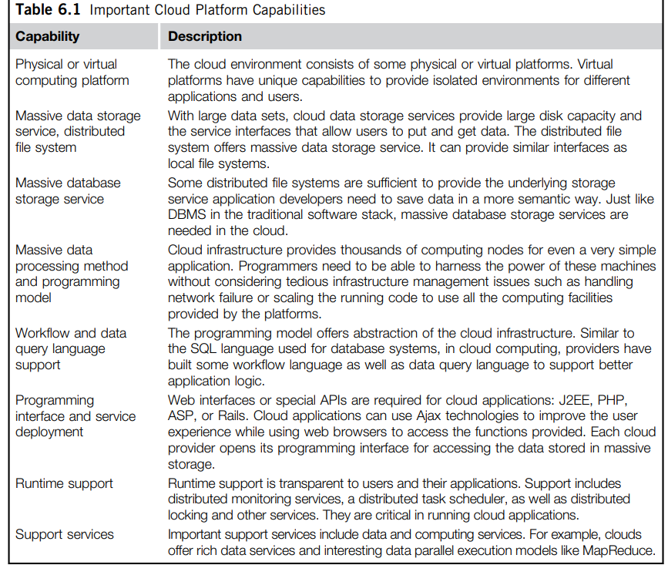
Traditional Features Common to Grids and Clouds
*
‹#›

Slide 23
*
‹#›

